Slide 1
Design & Analysis of Algorithms

Slide 2
Counting Sort

Slide 3
Comparison / Non Comparison sorts
A comparison sort examines the data only by comparing two elements with a comparison operator.
For example:
Bubble sort --O(n²)
Selection sort --O(n²⁾
Insertion Sort--O(n²)
Merge Sort --O(n log n)
Some examples of sorts which are not comparison sorts :
Radix sort,
Counting sort,
Bucket sort etc.

Slide 4
Stable sort
stable sort: A sort that preserves the input order among equal elements.
A:
4
1
3
4
3
B:
1
3
3
4
4

Slide 5
Counting Sort
We will consider Counting Sort algorithm that is faster and work by not making comparisons.
Counting sort assumes that the numbers to be sorted are in the range 0 to k where k is max number in input array.
We count the occurrence of each element in the array

Slide 6
Counting Sort Procedure
First of all built the following three arrays
Array A[1..n] stores the initial data to be sorted.
Array B[1..n] is used to store the final, sorted, list.
Array C[0..k] is used to count the occurrences of the data values

Slide 7
Counting Sort Algorithm Procedure
First for loop initializes C[ ] with zero.
Second for loop increments the values in C[ ], according to their occurrences in the data. +1 we added because C[ ] is initialized with zero and vice versa
Third for loop adds all previous values, making C[ ] contain a cumulative total.
Fourth for loop writes out the sorted data into array B[ ].

Slide 8
Counting Sort
Assumption:
The elements to be sorted are integers in the range 0 to k (k is max(A))
Idea:
Determine for each input element x
Place element x into its correct position in the output array
1
2
3
4
5
6
7
8
0
1
2
3
4
5
A
2
5
3
0
2
3
0
3
C
2
2
4
7
7
8
1
2
3
4
5
6
7
8
B
0
0
2
2
3
3
3
5

Slide 9
COUNTING-SORT
Δ note: K=max(A)
1
j
n
A
Alg.: COUNTING-SORT(A, B, n, k)
for i ← 0 to k
do C[ i ] ← 0
for j ← 1 to n
do C[A[ j ]] ← C[A[ j ]] + 1
for i ← 1 to k
do C[ i ] ← C[ i ] + C[i -1]
for j ← n downto 1
do B[C[A[ j ]]] ← A[ j ]
C[A[ j ]] ← C[A[ j ]] - 1
0
k
C
1
n
B
Notes:
C[A[ j ]] ← C[A[ j ]] + 1, because we are adding each element of array A to Array C(counting array), and for that we have initialized C with zero so that we can check the occurrences of each of the element of array A into an Array C.
C[ i ] ← C[ i ] + C[i -1] is used to build Array C as a Cumulative array(Statistical Cumulative array)

Slide 10
Analysis of Counting Sort
Alg.: COUNTING-SORT(A, B, n, k)
for i ← 0 to k
do C[ i ] ← 0
for j ← 1 to n
do C[A[ j ]] ← C[A[ j ]] + 1
for i ← 1 to k
do C[ i ] ← C[ i ] + C[i -1]
for j ← n downto 1
do B[C[A[ j ]]] ← A[ j ]
C[A[ j ]] ← C[A[ j ]] - 1
Θ(k)
Θ(n)
Θ(k)
Θ(n)
Overall time: Θ(n + k)

Slide 11
Analysis of Counting Sort
The time complexity goes as follows.
It takes O(K) time to initialize the array, O(N) time to read in the numbers and increment the appropriate element of counts, another O(K) to create the cumulative sum array, and another O(N) time to scan read through the list of students again, for a total runtime of O(N + K).

Slide 12
Analysis of Counting Sort
Time Complexity
Counting sort has a running time of Θ(n + k), where n is the number of elements to be sorted and k is the range of those numbers. If k = O(n), this algorithm has Θ(n) performance.
Space Complexity
Counting sort does not sort in place, since it creates two other arrays, counting array C and output array. The space complexity is Θ(n + k), where n and k are the length of the array A and C, respectively. No swap operations is performed during the process.

Slide 13
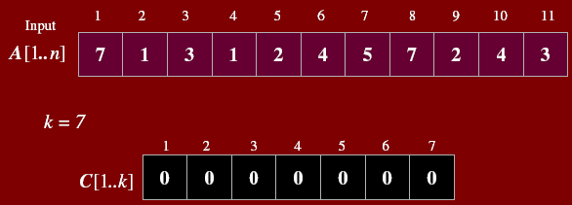
Example

Slide 14
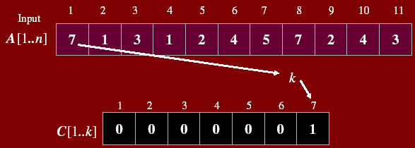
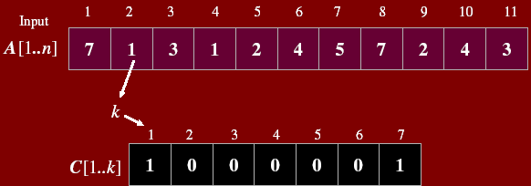

Slide 15
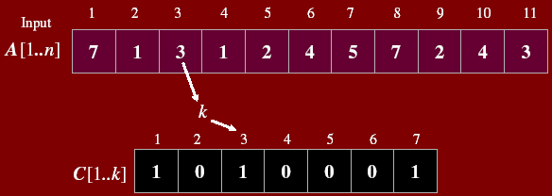
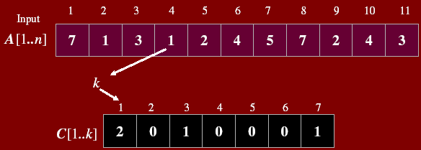

Slide 16
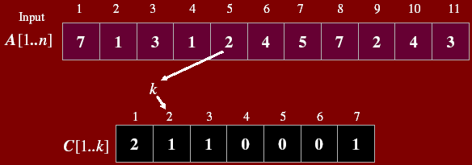
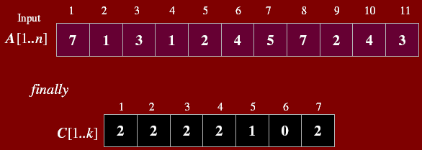

Slide 17
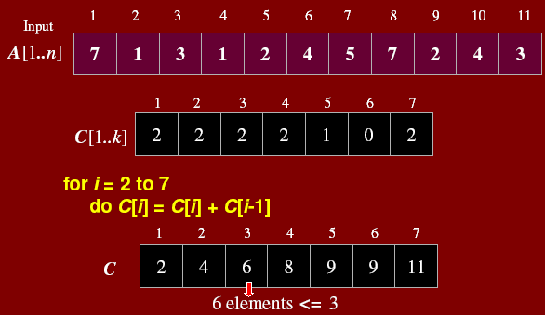

Slide 18
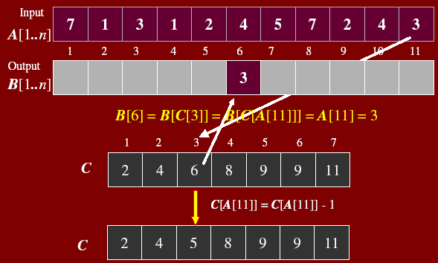

Slide 19
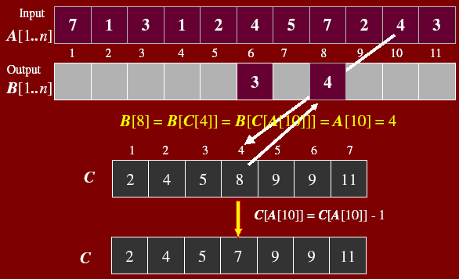

Slide 20
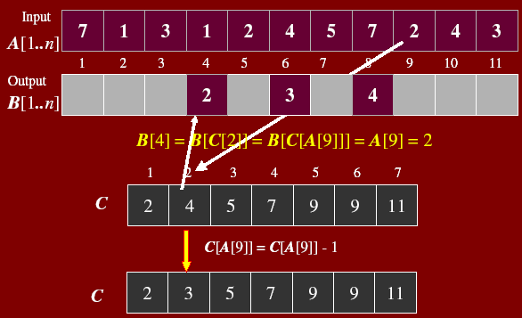

Slide 21
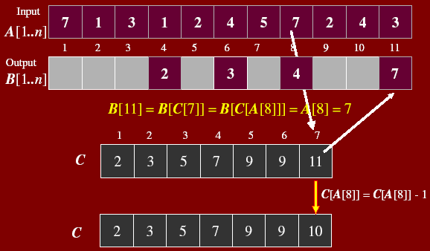

Slide 22
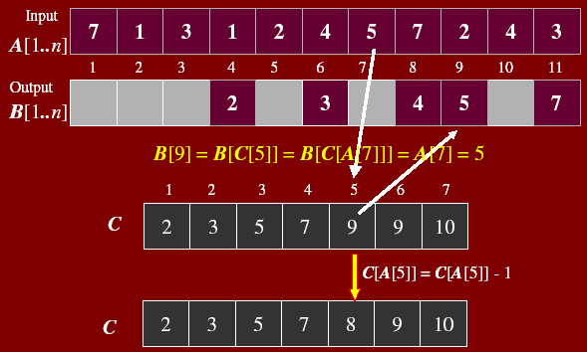

Slide 23
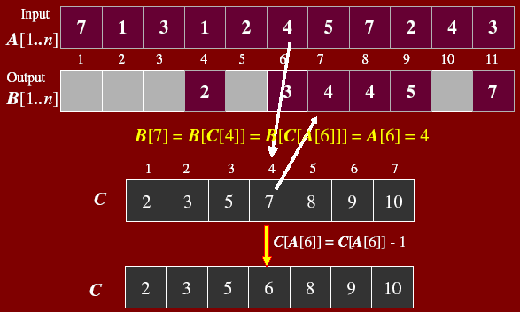

Slide 24
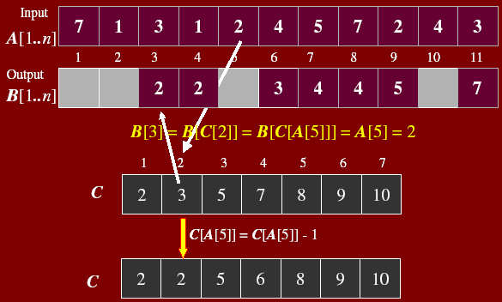

Slide 25
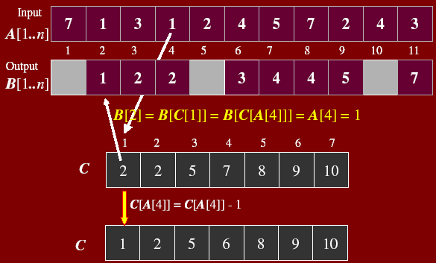

Slide 26
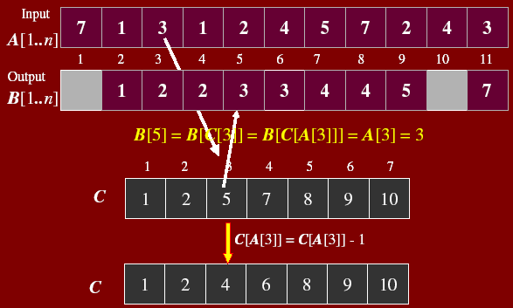

Slide 27
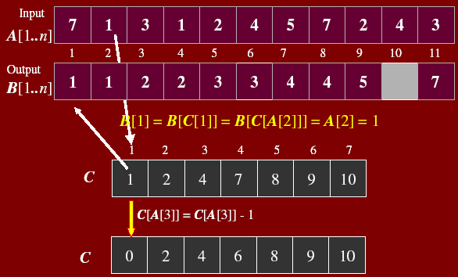

Slide 28
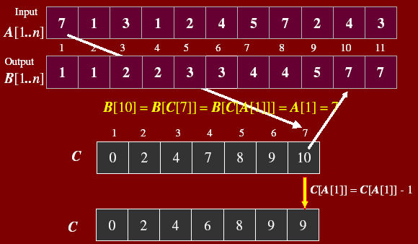

Slide 29
Example
1
2
3
4
5
6
7
8
0
1
2
3
4
5
A
2
5
3
0
2
3
0
3
C
2
2
4
7
7
8
0
1
2
3
4
5
Cumulative Array
C
2
0
2
3
0
1
Count repetition
1
2
3
4
5
6
7
8
1
2
3
4
5
6
7
8
B
3
B
0
3
0
1
2
3
4
5
0
1
2
3
4
5
C
2
2
4
6
7
8
C
1
2
4
6
7
8
1
2
3
4
5
6
7
8
1
2
3
4
5
6
7
8
B
0
3
3
B
0
2
3
3
0
1
2
3
4
5
0
1
2
3
4
5
C
1
2
4
5
7
8
C
1
2
3
5
7
8
Notes:
We deal with cumulative array instead of C

Slide 30
Example (cont.)
1
2
3
4
5
6
7
8
A
2
5
3
0
2
3
0
3
1
2
3
4
5
6
7
8
1
2
3
4
5
6
7
8
B
0
0
2
3
3
B
0
0
2
3
3
3
5
0
1
2
3
4
5
0
1
2
3
4
5
C
0
2
3
5
7
8
C
0
2
3
4
7
7
1
2
3
4
5
6
7
8
1
2
3
4
5
6
7
8
B
0
0
2
3
3
3
B
0
0
2
2
3
3
3
5
0
1
2
3
4
5
C
0
2
3
4
7
8

